Slide 1

Bikelytics
Data Interaction and Visual Analytics
CS 526
Spring 2022
Dheeraj Goli (dg1009)
Rishikesh Gawade (rkg63)
Laxman Srikanth Sista (ls1274)
Group 5

Slide 2


Datasets used
Weather Dataset
We plan to use Chicago’s basic daily weather recordings for the entire year to see how ridership is affected by weather.
Type: Spatio-temporal, at rest.
No. of records: ~9000
Size of a record: ~70 bytes
Overall Size - 8 MB
Trip Dataset
We use the spatiotemporal data from Divvy Bikes which is updated every month.
On an average, every month about a 200K+ trips are recorded, which varies with seasonality.
Type: Spatio-temporal, at rest.
No. of records: ~3.5 million
Size of a record: ~250 bytes
Overall Size ~ 1.5 GB

Slide 3

Data Dictionary
Weather Data Attributes
Daily Min and Max Temperature
Precipitation Percentage
Wind Speed
Humidity
Date & Time
Categorical Attributes - 2
Numerical Attributes - 4
Trip Data Attributes
Trip/Bike ID
Bike Type (Classic/Electric)
Start date & Time
End date & Time
Duration
Source name & ID
Destination name & ID
User type
Gender & Birth Year of user
Categorical Attributes - 8
Numerical Attributes - 1

Slide 4
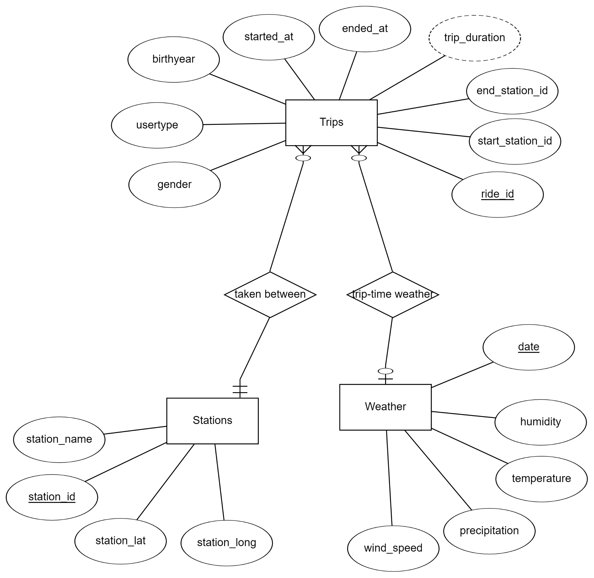
ER Diagram

Slide 5
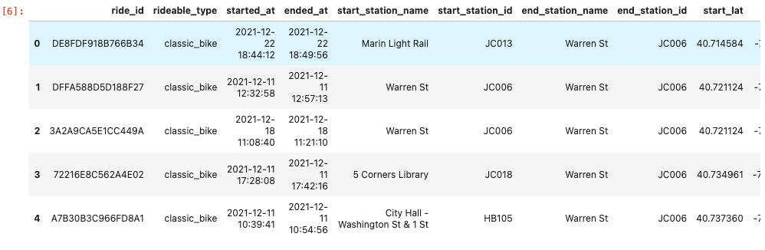
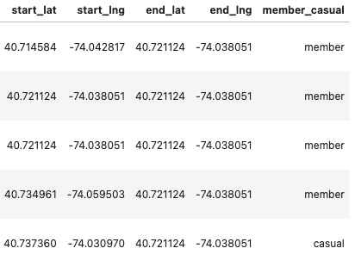
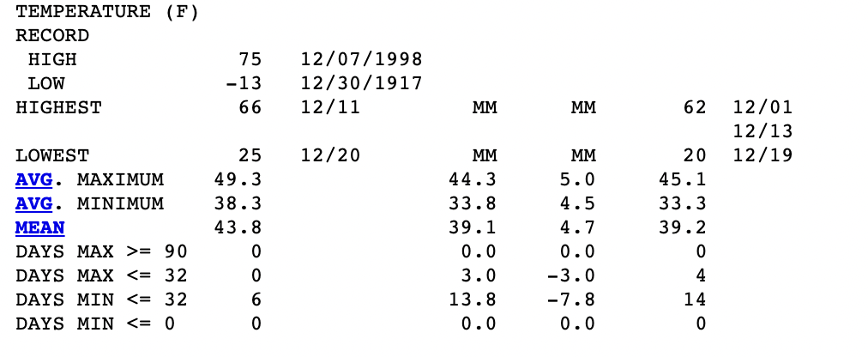
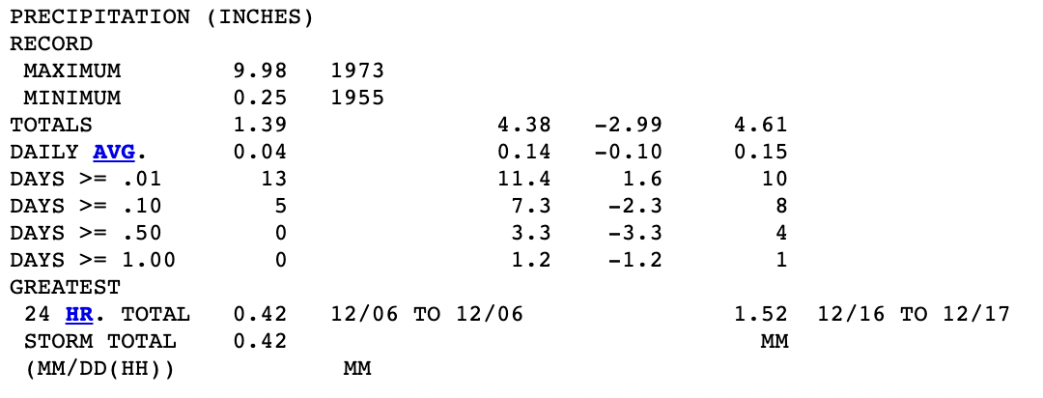
Data Snippets

Slide 6
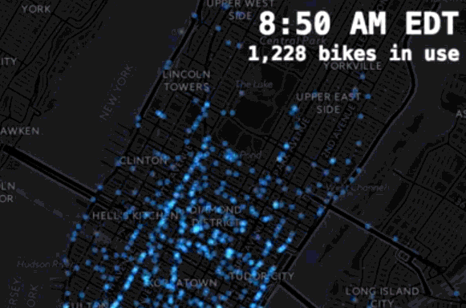
Fundamental Questions & Expected Users
We aim to help the companies plying and operating bikes to monitor the usage of their bike services across the city so as to effectively tune their operations based on the usage.
How many trips are taken everyday?
Route-wise, Source-wise and destination-wise usage of bikes given a type of day (weekend/weekday) and even time.
Trends of ridership - overall, based on seasons, weather and day type.
Identify bottlenecks in the service.
User-data analysis, gender and age of the riders
Notes:
How many trips have been recorded during the chosen period
By what percentage has total ridership grown
How has the proportion of short-term customers and annual subscribers changed
What is the gender breakdown of active participants (Male v. Female)
How effective has gender outreach been in increasing female ridership over the timespan
What are the peak hours in which bikes are used during summer months?
What are the peak hours in which bikes are used during winter months?
What are the top 10 stations in the city for starting a journey
What are the top 10 stations in the city for ending a journey
What are the bottom 10 stations in the city for starting a journey
What are the bottom 10 stations in the city for ending a journey
How does the average trip duration change by age
What is the average distance in miles that a bike is ridden
Which bikes (by ID) are most likely due for repair or inspection in the timespan
How variable is the utilization by bike ID

Slide 7
Fundamental Questions & Expected Users (Contd.)
Explore strongly and weakly connected regions of the city and check the overall flow between the regions
The expected users for this are:
Bike Share Operators
City Transport Council Advisors
Business analysts

Slide 8
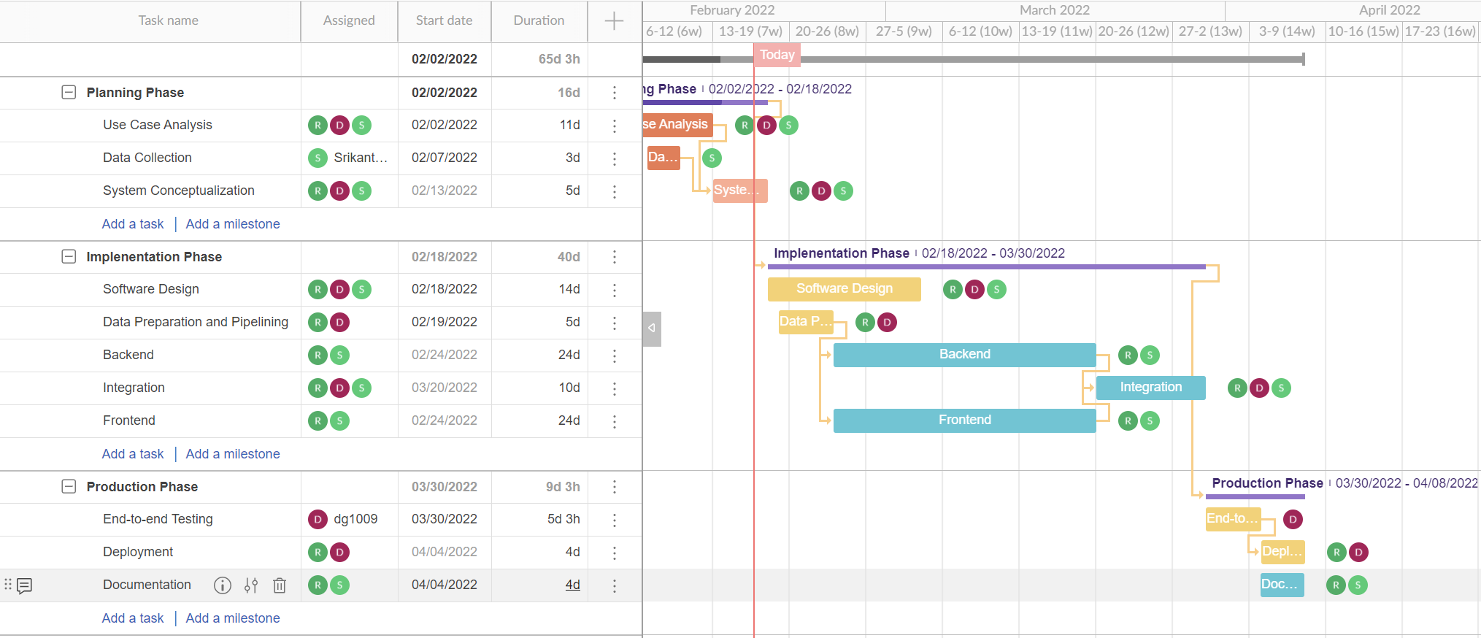
Project Timeline (Gantt Chart)

Slide 9
Technology Stack
Modes of Processing
Initially storing files in S3 buckets
Cleaning the data
Creating jobs for preprocessing and creating cold & hot data stores
Exposing APIs to query the aforementioned stores
High-throughput, read-heavy database - PostgreSQL.
Spark+Hadoop for preprocessing/heavy processing jobs.
Flask for exposing data via APIs
Bootstrap.js, AMCharts, Plotly.js, Flowmap.js

Slide 10
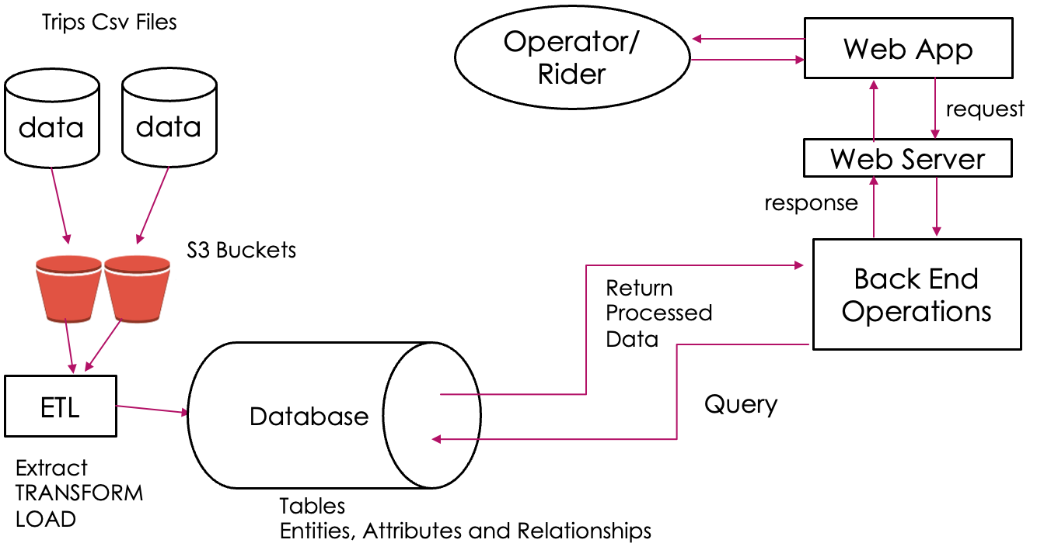
Work/Data Flowchart

Slide 11
Visual Representation
Bikelytics, as a web application, employs a client-server architecture with MVC (Model, View, Controller) design pattern.
The charts used have been created using charts and figures from AMCharts, Plotly.js and Flowmap.Blue.
Scatter maps, heat maps, flow maps, bar charts, and more are implemented.
The application has three main interactive views:
Dashboard page,
Stations page,
User statistics page

Slide 12
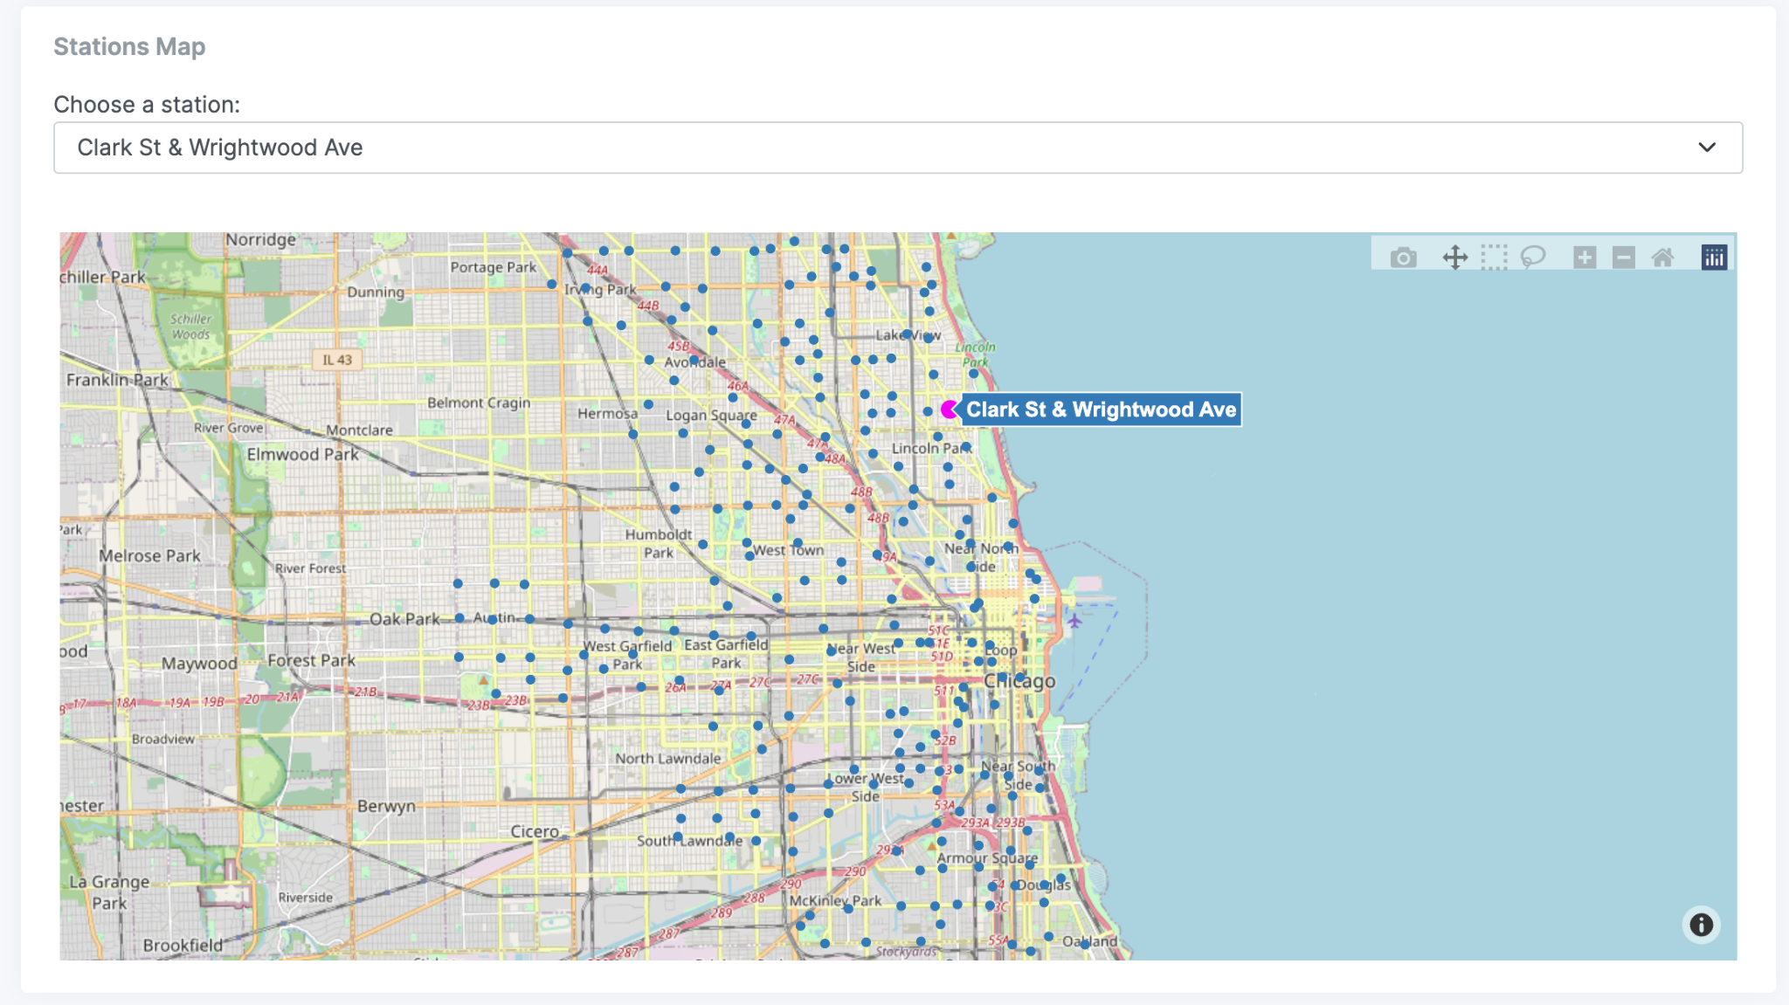
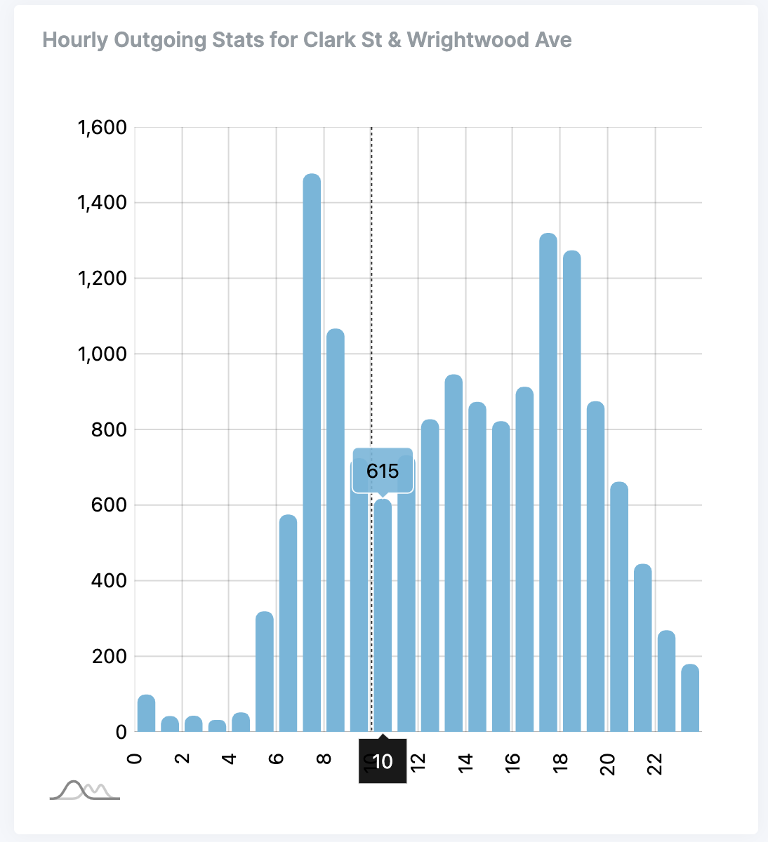
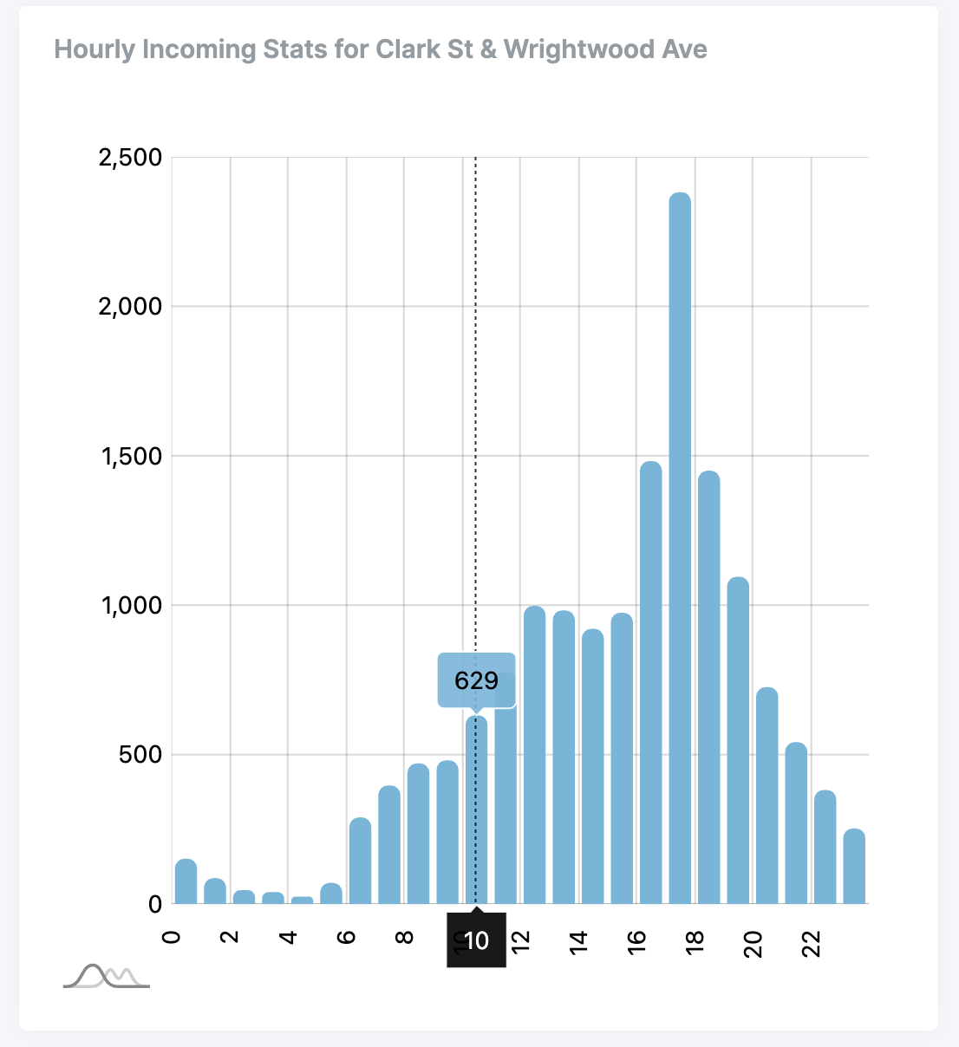
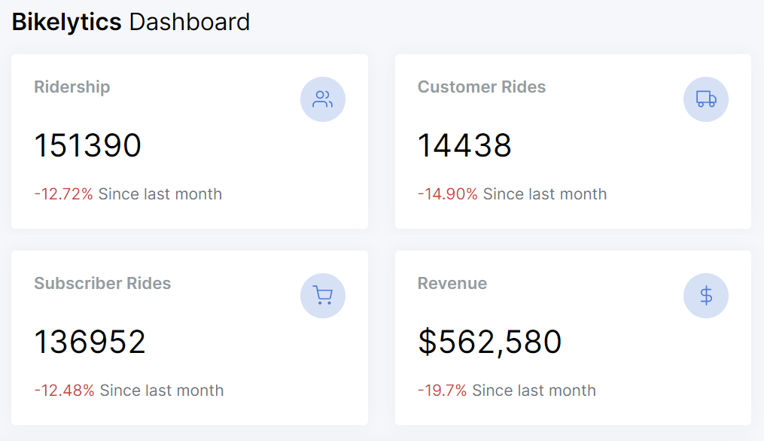

Slide 13
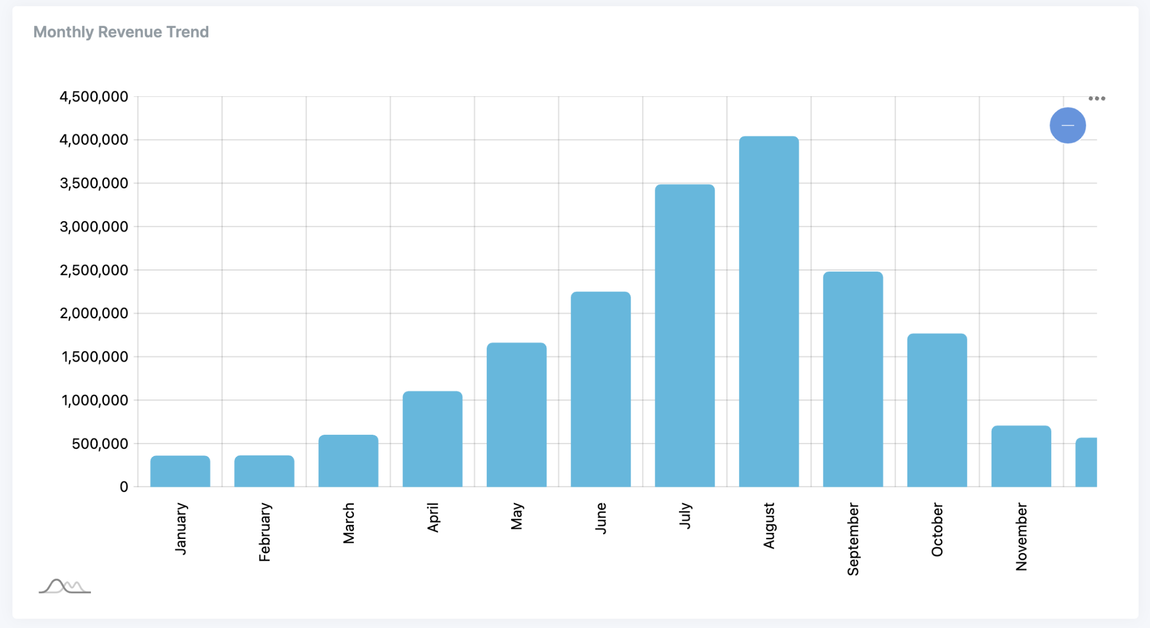
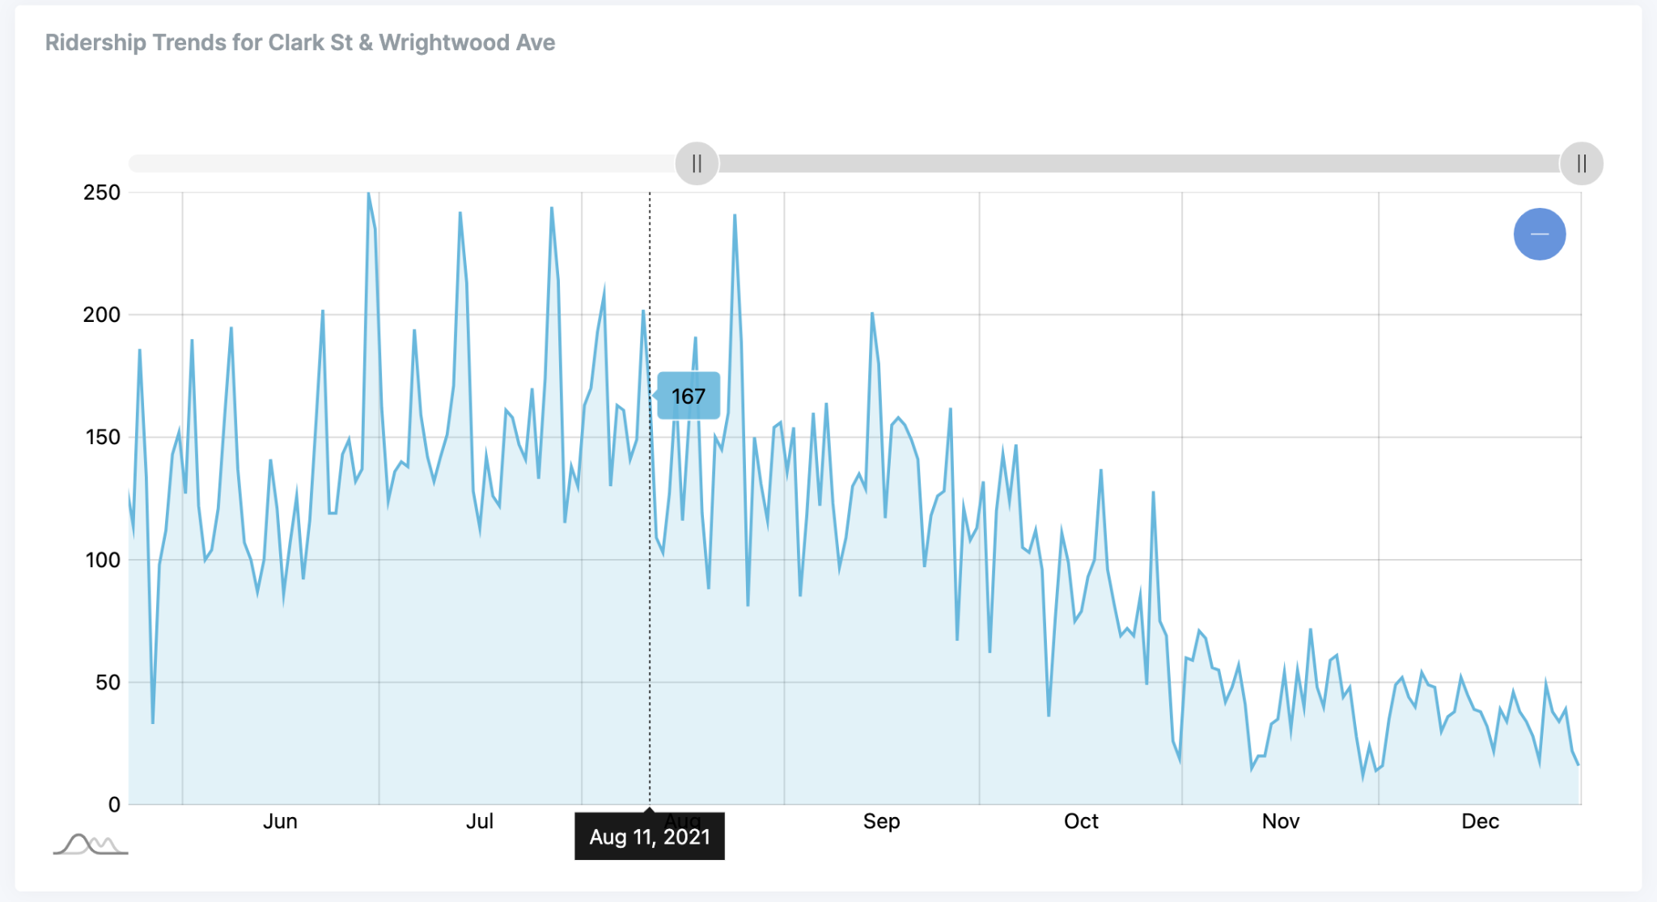
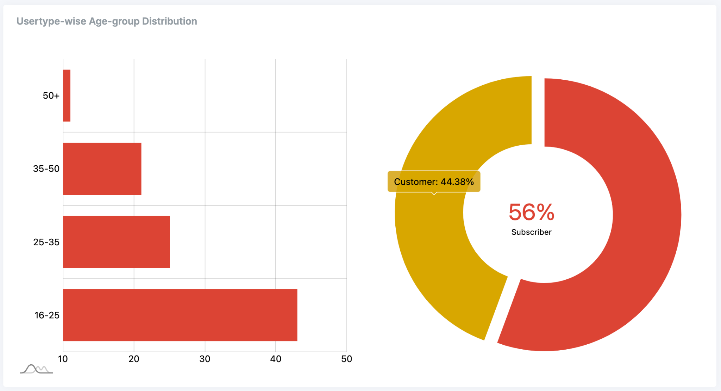

Slide 14
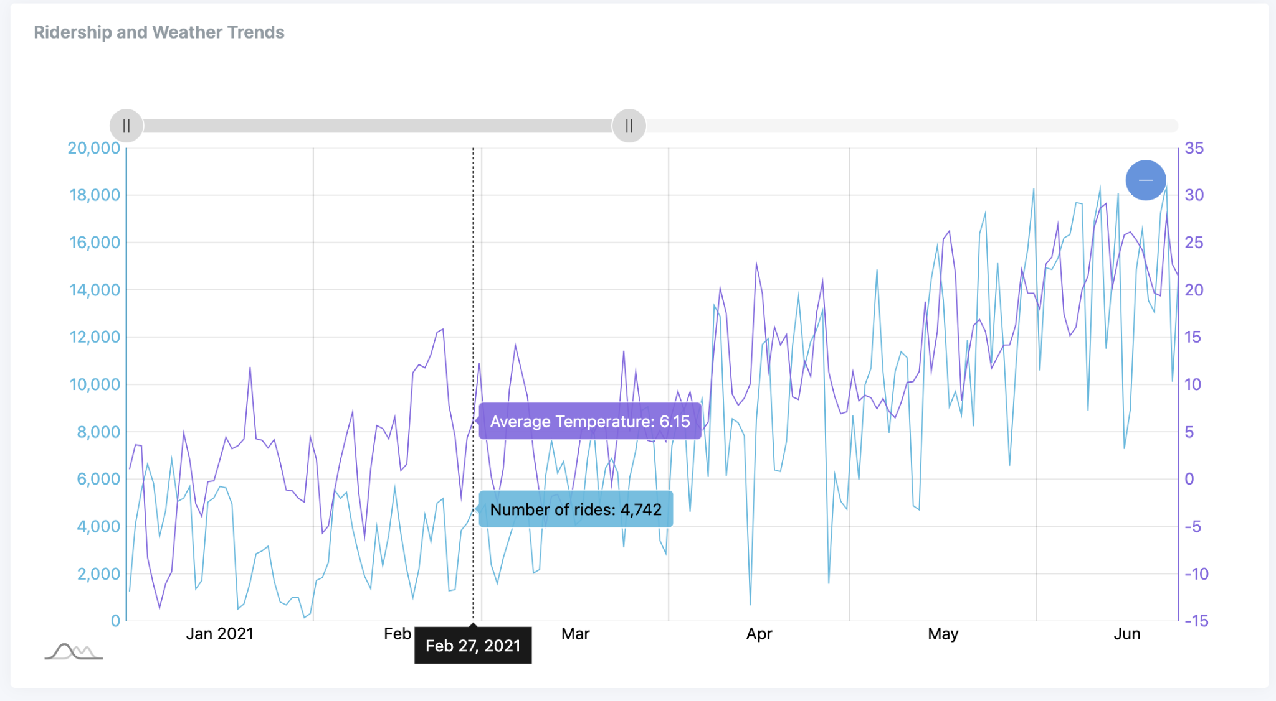
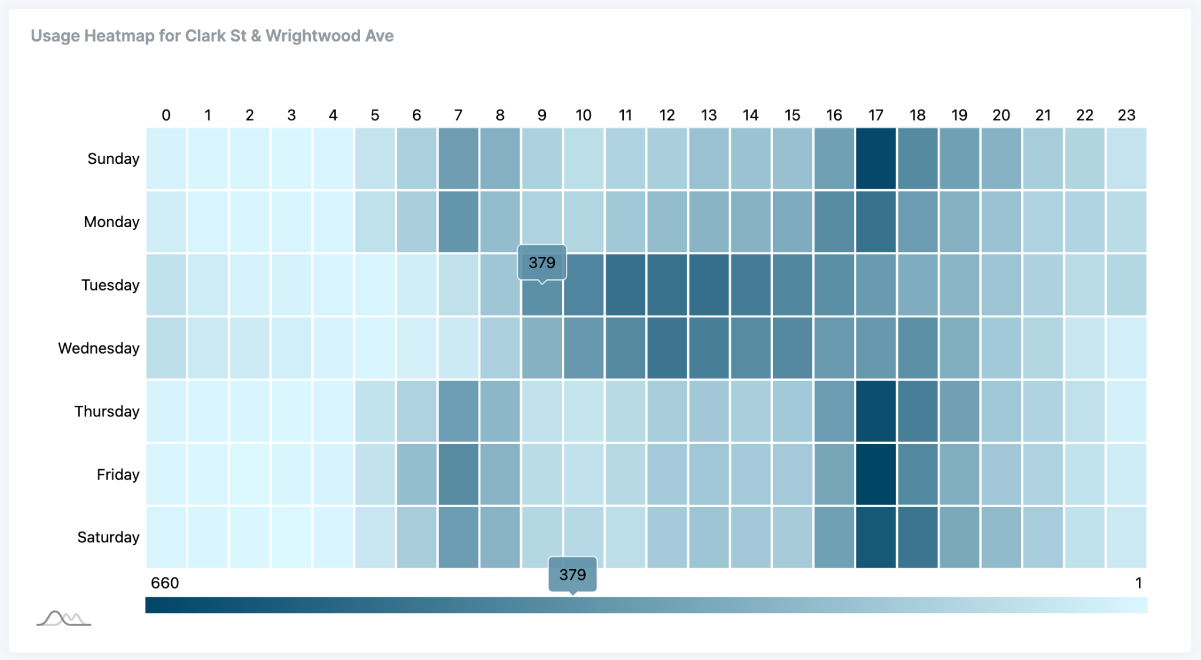
Interactivity
Some of the interactions integrated are:
Dragging
Hovering
Zooming
Edge & Vertex Selection
Brushing
Sliders
Labeling
Linking of different views

Slide 15
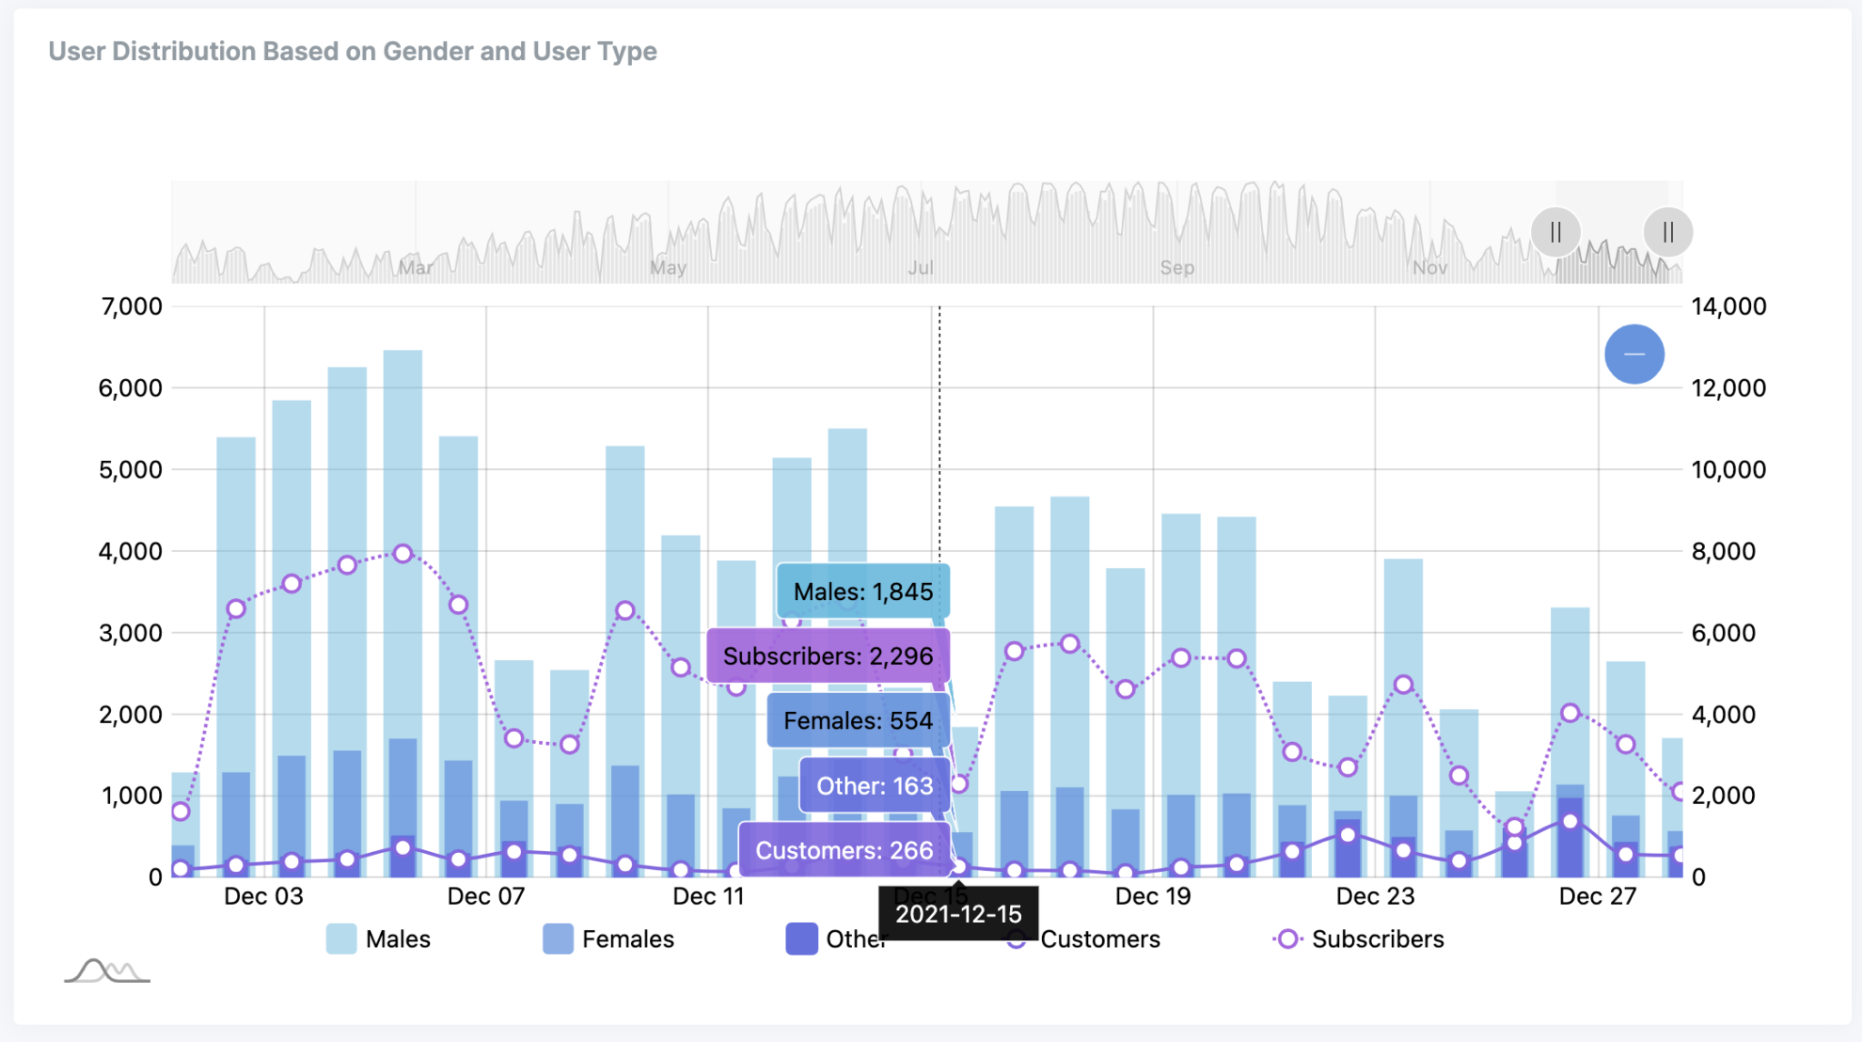

Slide 16
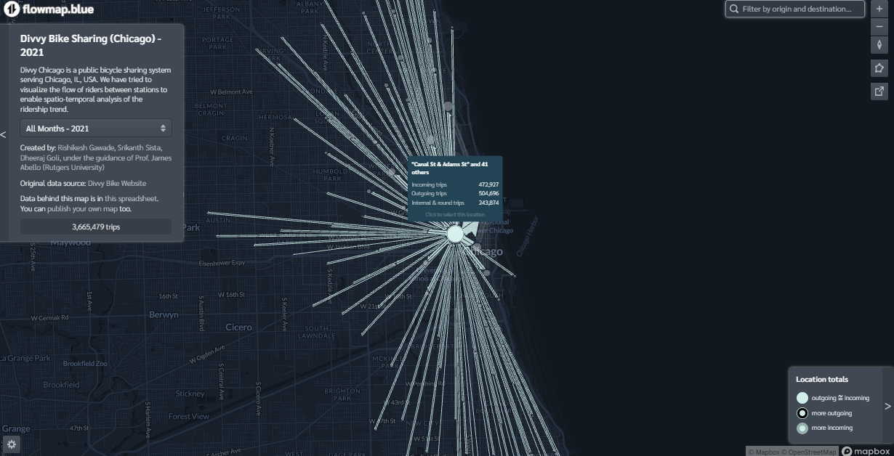

Slide 17
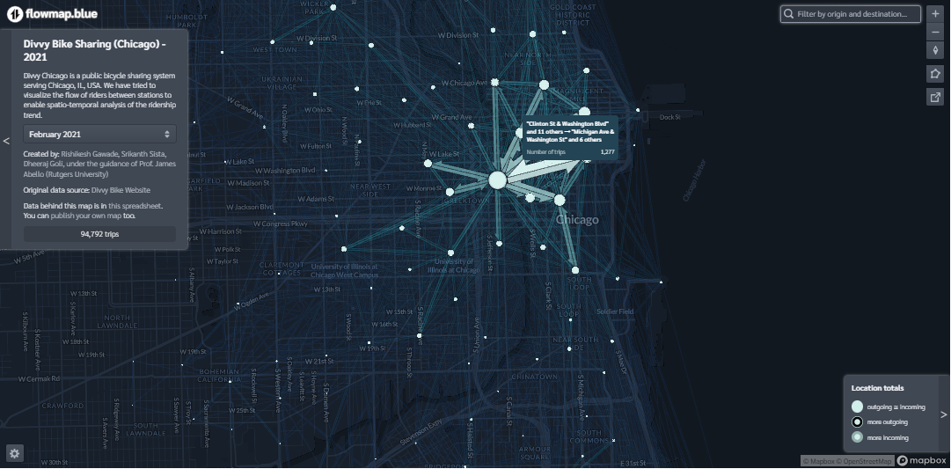

Slide 18
Analytics & Evaluation
The views are interconnected and seamlessly update when new data is added or when another view is interacted with.
The application summarizes and gives a high-level picture of the bike services. It describes the overall performance and trends, and the flow between regions and stations.
All of the charts and maps can be reused for any other bike-sharing services setup in other popular cities.

Slide 19
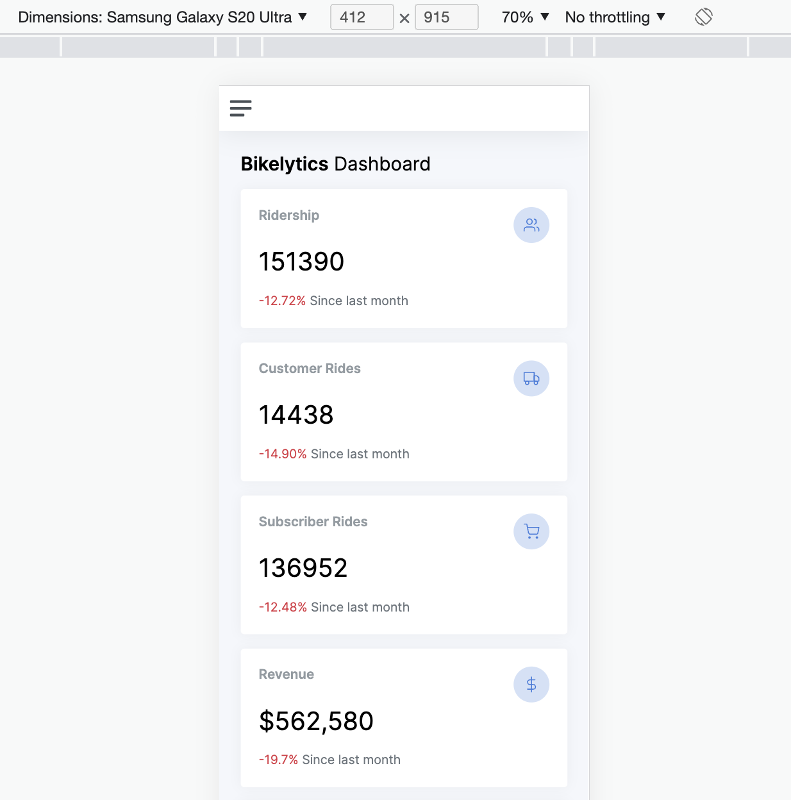
Future Work
Extend the analysis of the project to all bike sharing systems in major metropolitan cities.
Build a mobile version of the application so that people can get insights on the go.
Compare the usage of different modes of transport in the city.
Build charts and summaries accessible to general users.

Slide 20
References
Divvy Bike System Data
Climatological Data

Slide 21
Thank you!

